Slide 1
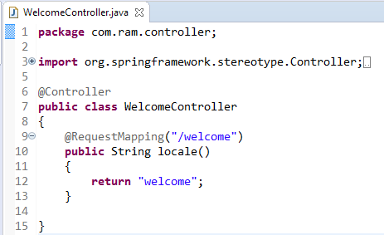
Spring Boot - Thymeleaf
Thymeleaf is a Java-based library used to create a web application. It provides a good support for serving a XHTML/HTML5 in web applications.
In the above example, the request URI is /welcome, and the control is redirected into the welcome.html file. Note that the welcome.html file should be placed under the templates directory and all JS and CSS files should be placed under the static directory in classpath.

